Slide 1
PROJECT
Topic: ENGINEERING A STUDENT HOSTEL MANAGEMENT SYSTEM
WORKED BY: VANGJEL DHIMA, BINF 3 B
COURSE: SOFTWARE ENGINEERING

Slide 2
The reason for the application development
Student hostels are types of residences that provide tenants with common spaces to meet up
the students can live in a single or shared room and can be able to take advantage of the common spaces to meet other students and carry out their daily activities
Without a management system, student hostels are typically run manually. There is a lot of pressure on the person in charge of the hostel.
Therefore, an application could really help to manage student hostels more effectively and efficiently.

Slide 3
How the work was structured
Identifying the problem and coming up with the proposed solution
Reviewing similar work done
identifying user requirements and application specifications
designing and modeling the software
Writing the html code and creating all the database tables
writing all the php code for the application back-end

Slide 4
How the work was structured (continued)
Improving the look and feel of the application using CSS
Validating, testing and debugging the application
note: This application was developed from scratch

Slide 5



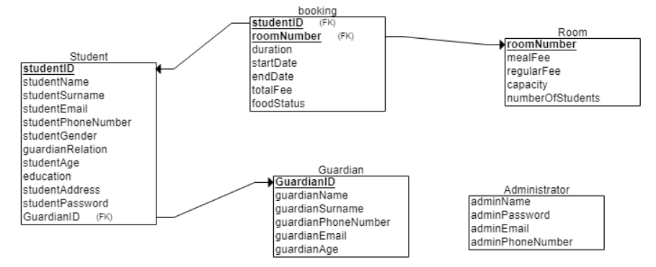
Database relational schema

Slide 6
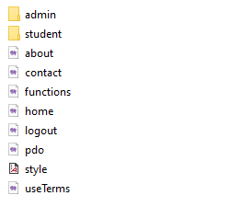
Application files and folders

Slide 7
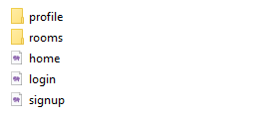
Student panel files and folders

Slide 8
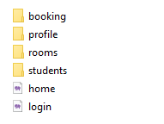
Admin panel files and folders

